Slide 1

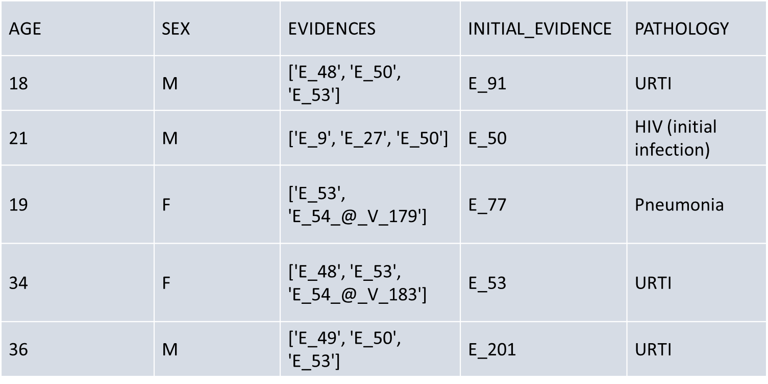
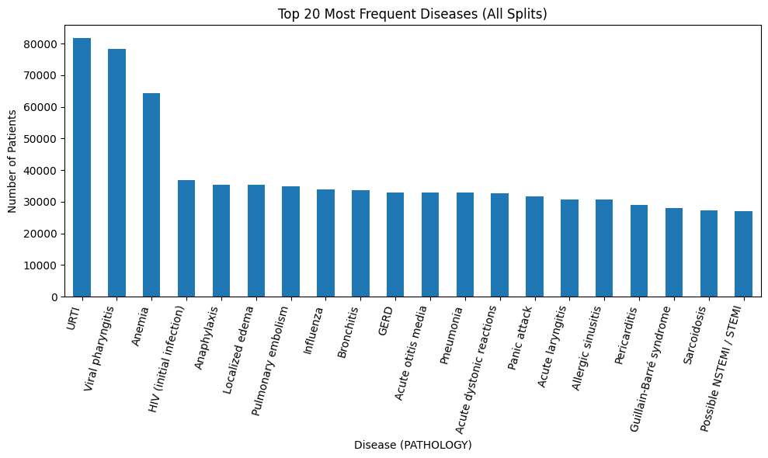
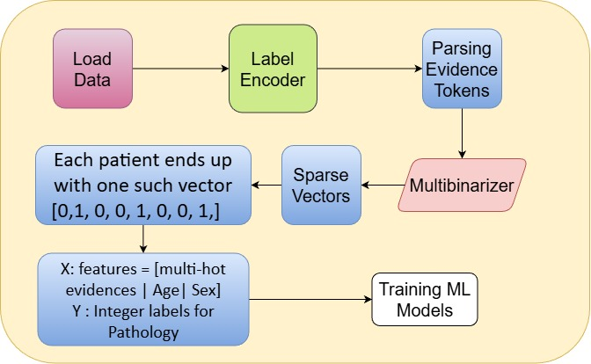
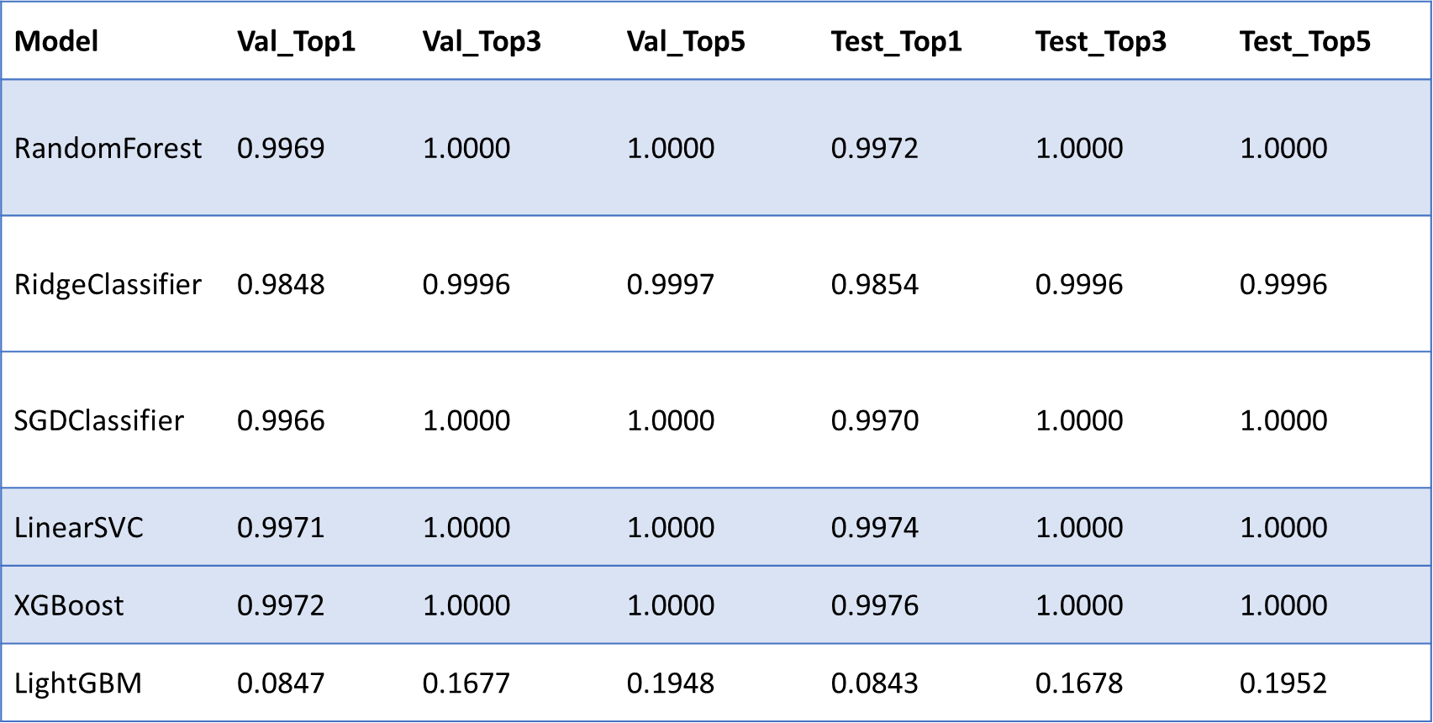
Evidence-Driven Differential Diagnosis: A Machine-Learning Framework Integrating
Structured Patient Data and Metadata-Derived Human-Readable Clinical Evidence
S. M. Masum (21-45807-3), Susmita Alam Athina (21-45411-3), Faria Nusrat Binte (20-44284-3), Sagor Saha (21-45074-2)
Introduction
Differential diagnosis is a core component of clinical decision-making, involving the generation and prioritization of possible diseases based on a patient’s presenting symptoms [1]. Failure to consider alternative diagnoses contributes to medical errors, which remain one of the most critical patient-safety challenges worldwide [2]. Factors such as atypical presentations, cognitive overload, and limited time further increase diagnostic uncertainty in outpatient settings [3]. Machine learning (ML) and artificial intelligence (AI) have become central to this effort, as they can detect complex patterns in large clinical datasets and generate predictions from structured features without explicit programming [4], [5], [6]. ML models—including support vector machines, gradient-boosting methods, random forests, and deep learning architectures—have demonstrated promising diagnostic performance across various medical domains [7], [8]. Emerging large language models (LLMs) offer new opportunities to interpret structured and unstructured medical data and support diagnostic reasoning across multiple disease categories [9]. This motivates the development of a scalable DDx framework capable of handling diverse conditions while improving interpretability and clinical usability.
Methodology
We converted patient evidence tokens into sparse multi-hot vectors, encoded pathology labels, trained six modern ML models, and compared their Top-1/Top-3/Top-5 diagnostic accuracy on validation and test sets.
Dataset containing synthetic patient records. Each patient includes evidence tokens, age, sex, and a pathology label. Loaded train, validation, and test splits from CSV files.
Evidence lists stored as strings (e.g., "['E_48','E_53']") were converted into real Python lists. Using the training split, a MultiLabelBinarizer was fitted to extract all unique evidence. Each patient’s evidence list → converted into a multi-hot vector.
Feature Engineering SEX encoded numerically (M = 1, F = 0).AGE missing values imputed using the median.
Feature Matrix Construction Final input feature vector per patient:[ Evidence multi-hot vector | AGE | SEX ] Created sparse matrices for efficient training. X_train, X_val, X_testLabels encoded using LabelEncoder → y_train, y_val, y_test
Model Evaluation For each model, computed:Top-1 Accuracy: correct single prediction Top-3 Accuracy: true pathology among top 3 predictionsTop-5 Accuracy: true pathology among top 5 predictions Evaluation done on both validation and test data. All results summarized into one comparison table.
Data Analysis
Dataset :
Key fields in the dataset are :
Age – Used as a numerical feature.
Sex – Converted into numeric form for the model.
Evidences – A list of coded clinical findings (symptoms, signs, lab clues). Each token represents a specific clinical observation, such as “cough,” “fever,” or “pain severity”. These codes are transformed into a multi-hot vector, forming the main feature set for model training.
Initial evidence – The first presenting symptom; not used in the current model.
Pathology – The final confirmed diagnosis. This is the target variable the model learns to predict.
This figure shows the 20 most common diseases in the dataset across all splits, highlighting how frequently each pathology appears. Conditions such as URTI, viral pharyngitis, and anemia dominate the distribution.
Results
Linear models (Logistic-style, SVM, SGD, Ridge) performed well, achieving >98% Top-1 accuracy and perfect Top-3/Top-5 across validation and test sets. Random Forest and
XGBoost also showed near-perfect performance, matching or slightly exceeding the linear models.
LightGBM was the only model that performed poorly, likely due to sensitivity to sparse input format or the need for hyperparameter tuning.
Conclusion
Unlike prior studies focused on binary or small-class diagnostic tasks, this work demonstrates a scalable machine-learning framework.
This framework is capable of generating differential diagnosis across 49 distinct pathologies.
The study incorporates human-readable evidence from metadata.
Future directions include developing AI-driven clinical chatbots that leverage these human-interpretable evidences and incorporating LLM-based reasoning to build explainable, conversational diagnostic agents.
References
Leeds, F. S., Atwa, K. M., Cook, A. M., Conway, K. A., & Crawford, T. N. (2020). Teaching heuristics and mnemonics to improve generation of differential diagnoses. Medical Education Online, 25(1). https://doi.org/10.1080/10872981.2020.1742967
Miyachi, Y., Ishii, O., & Torigoe, K. (2023). Design, implementation, and evaluation of the computer-aided clinical decision support system based on learning-to-rank: collaboration between physicians and machine learning in the differential diagnosis process. BMC medical informatics and decision making, 23(1), 26. https://doi.org/10.1186/s12911-023-02123-5
13 Harada, Y., Katsukura, S., Kawamura, R., & Shimizu, T. (2021). Efficacy of Artificial-Intelligence-Driven Differential-Diagnosis List on the Diagnostic Accuracy of Physicians: An Open-Label Randomized Controlled Study. International Journal of Environmental Research and Public Health, 18(4), 2086. https://doi.org/10.3390/ijerph18042086
Cao, S., Yang, S., Chen, B., Chen, X., Fu, X., & Tang, S. (2024). Establishing a differential diagnosis model between primary membranous nephropathy and non-primary membranous nephropathy by machine learning algorithms. Renal failure, 46(2), 2380752. https://doi.org/10.1080/0886022X.2024.2380752
14 Cau, R., Pisu, F., Suri, J. S., Montisci, R., Gatti, M., Mannelli, L., Gong, X., & Saba, L. (2024). Artificial Intelligence in the Differential Diagnosis of Cardiomyopathy Phenotypes. Diagnostics, 14(2), 156. https://doi.org/10.3390/diagnostics14020156
16. Ferrara, M., Franchini, G., Funaro, M., Cutroni, M., Valier, B., Toffanin, T., ... & Grassi, L. (2022). Machine Learning and Non-Affective Psychosis: identification, differential diagnosis, and treatment. Current Psychiatry Reports, 24(12), 925-936.
12. Cha, D., Pae, C., Lee, S. A., Na, G., Hur, Y. K., Lee, H. Y., ... & Park, H. J. (2021). Differential biases and variabilities of deep learning–based artificial intelligence and human experts in clinical diagnosis: Retrospective cohort and survey study. JMIR Medical Informatics, 9(12), e33049.
4. Jeong, Y. S., Jeon, M., Park, J. H., Kim, M. C., Lee, E., Park, S. Y., Lee, Y. M., Choi, S., Park, S. Y., Park, K. H., Kim, S. H., Jeon, M. H., Choo, E. J., Kim, T. H., Lee, M. S., & Kim, T. (2021). Machine-Learning-Based Approach to Differential Diagnosis in Tuberculous and Viral Meningitis. Infection & chemotherapy, 53(1), 53–62. https://doi.org/10.3947/ic.2020.0104
22. Jung, J., Phillipi, M., Tran, B. et al. Accuracy of large language models in generating differential diagnosis from clinical presentation and imaging findings in pediatric cases. Pediatr Radiol 55, 1927–1933 (2025). https://doi.org/10.1007/s00247-025-06317-z
Acknowledgement
Grateful to American International University-Bangladesh (AIUB) for providing essential resources. Thankful for the supportive academic environment that enabled this study. Honoured to represent AIUB in promoting data-driven healthcare solutions. Appreciate Aiub’s commitment to promoting significant research and societal welfare.
Department of Computer Science, Faculty of Science and Technology.
American International University-Bangladesh (AIUB)

